Slide 1

My Angular Project
Raga Ranjini R
19001198

Slide 2
Drama Fandom
What is the term “Drama” mean ?
Drama is nothing but a web series which mostly consists of 12 – 30 episodes.
It gets telecasted in television like a serial but only twice a week.
Dramas are popular in regions like Korea, Japan and China.
People around other regions can watch these dramas in applications like Rakuten Viki and HiTV.

Slide 3

Introduction
Though there are applications to enable people obsessed with dramas to watch latest dramas. There is no popular platform to recommend entertaining ones according to persons’ preferences.
Taking this itself as a problem statement I have developed this Single Page Application.
Let’s take a look into the application and find out what features I have enhanced .

Slide 4
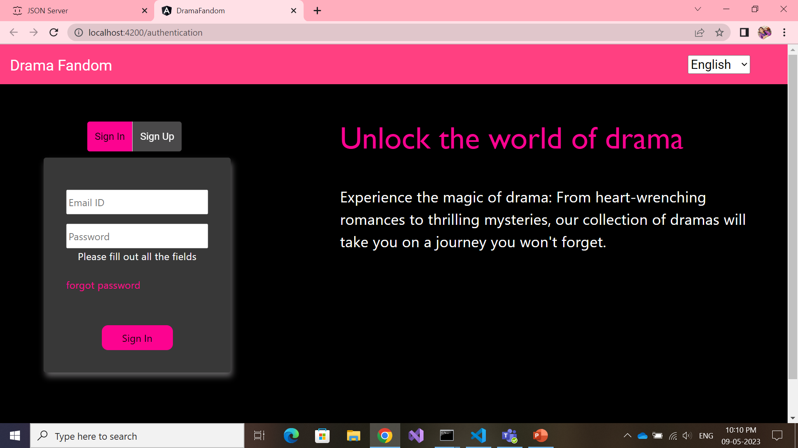
Sign In and Sign Up

Slide 5
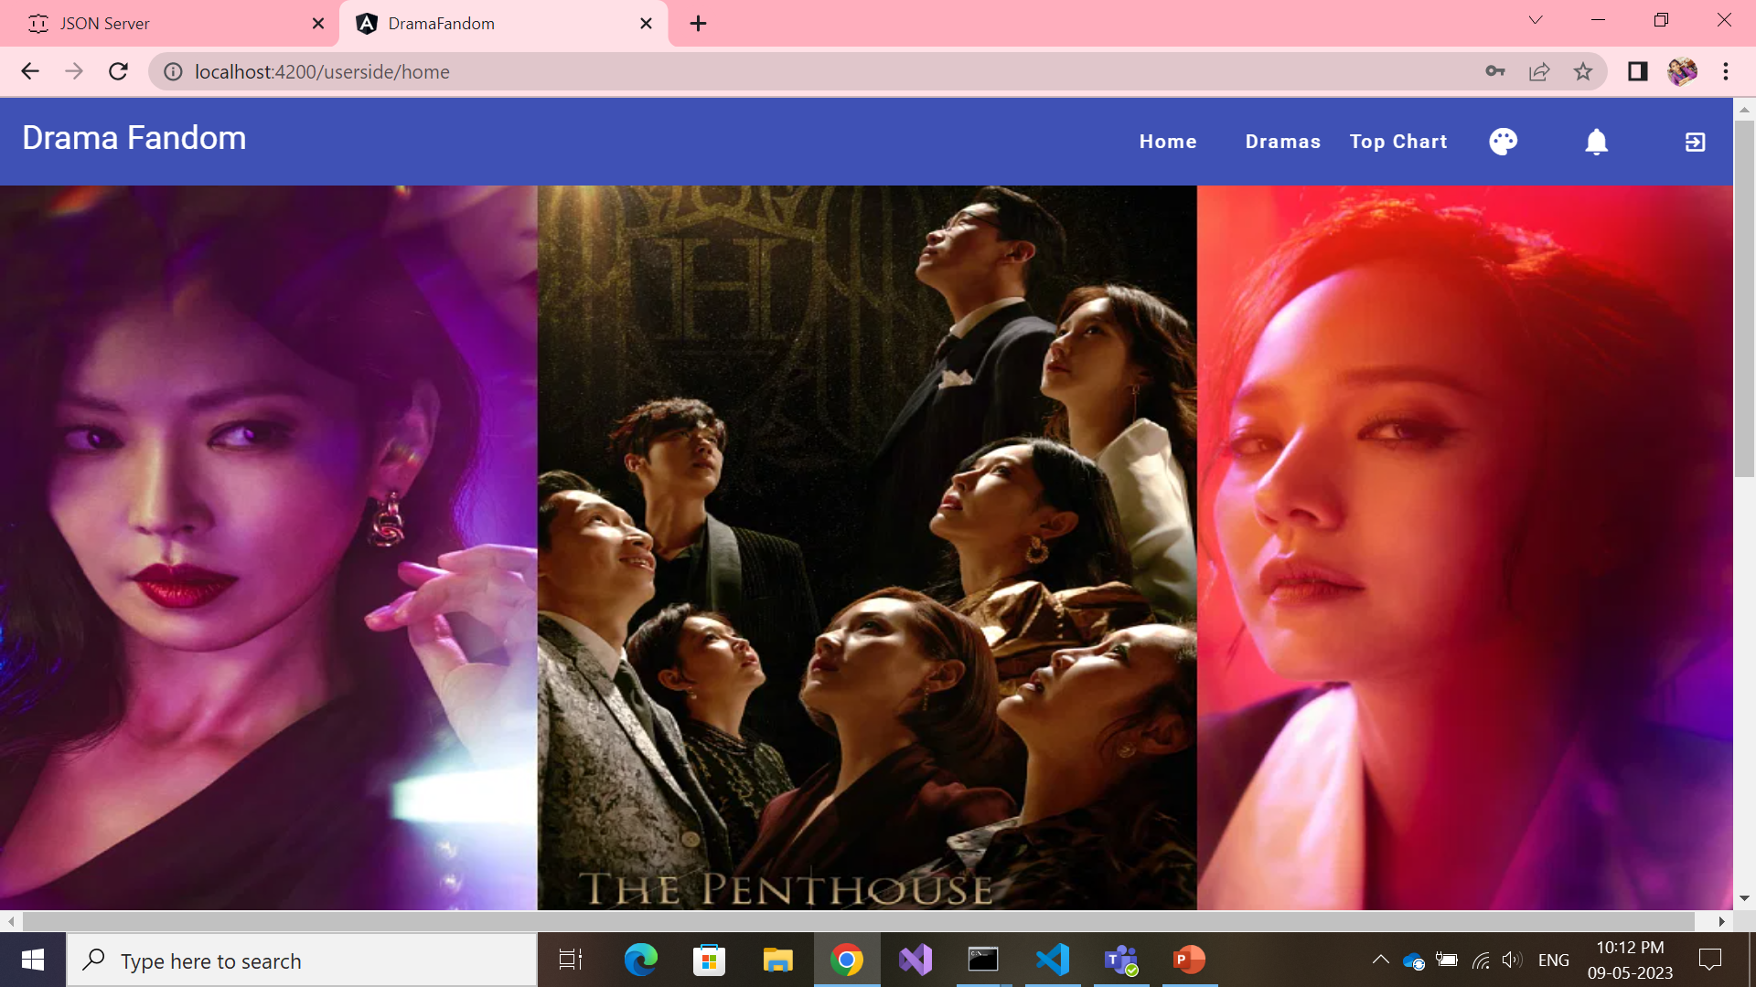
User Home Page

Slide 6
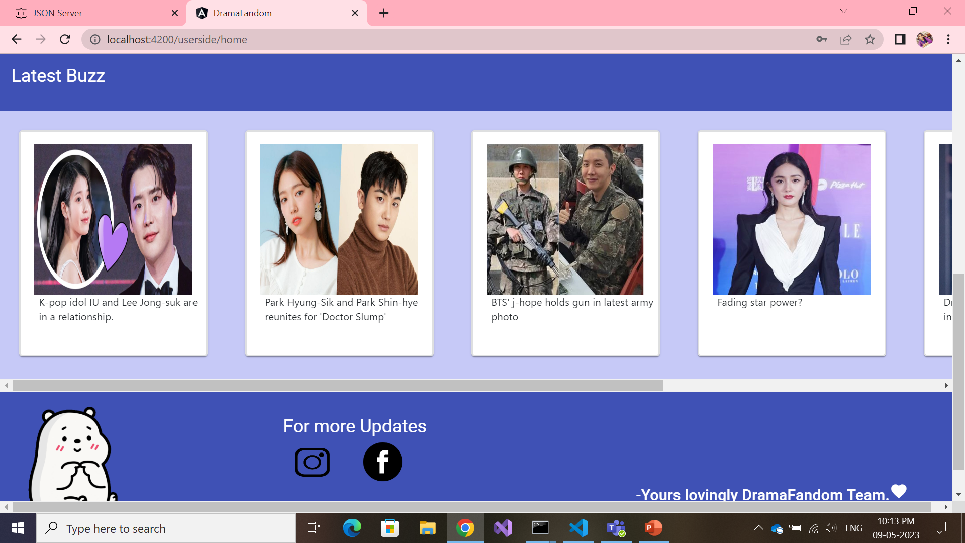
User Home Page

Slide 7
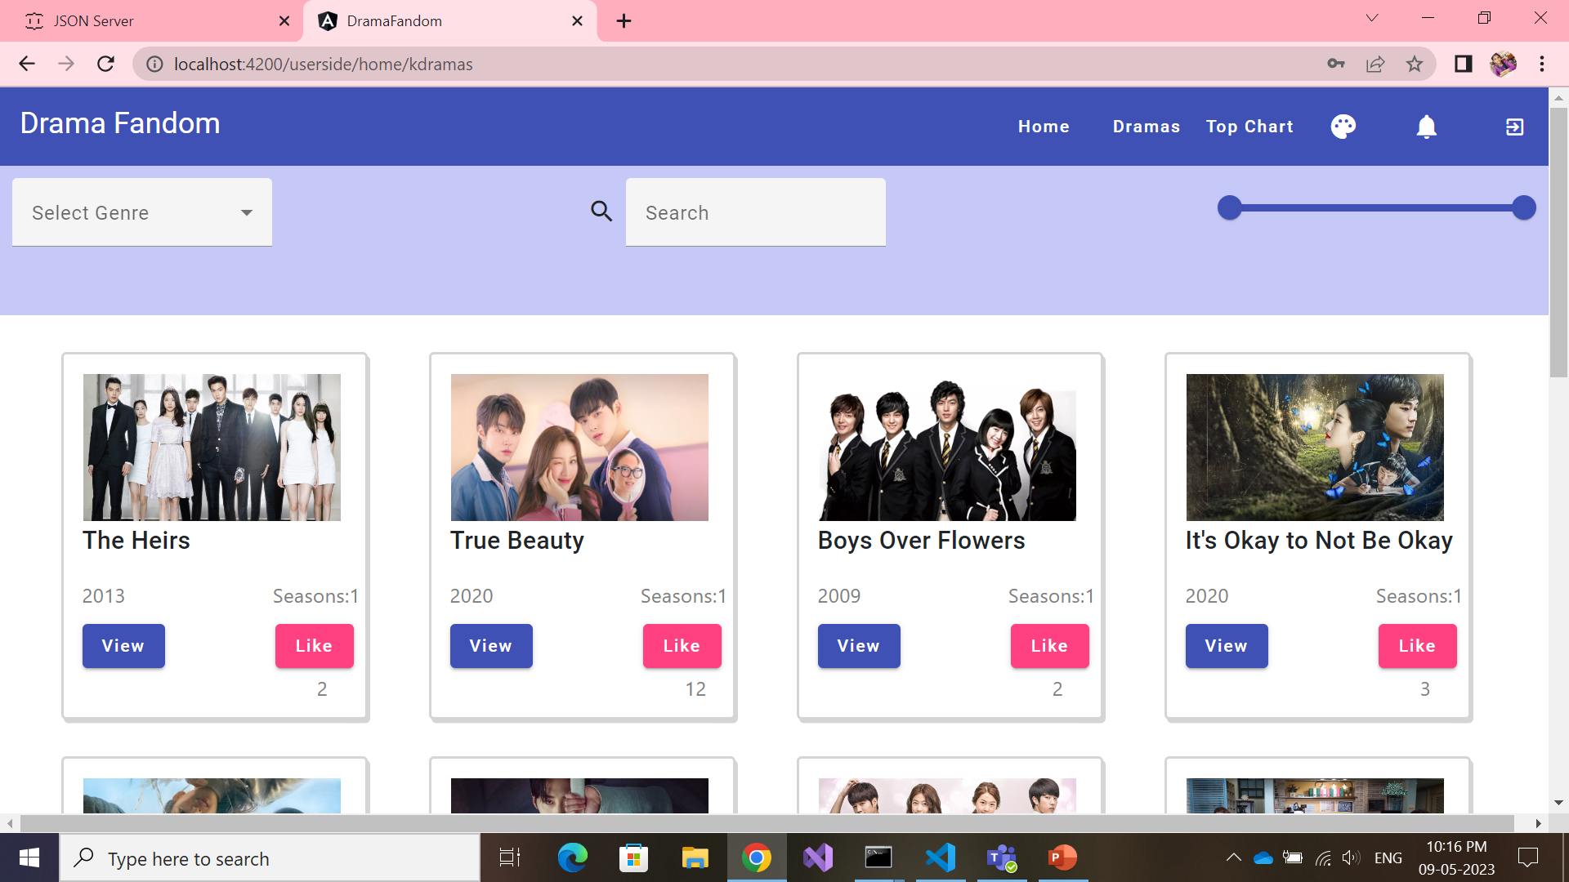
Dramas – Kdramas, Cdramas, Jdramas

Slide 8
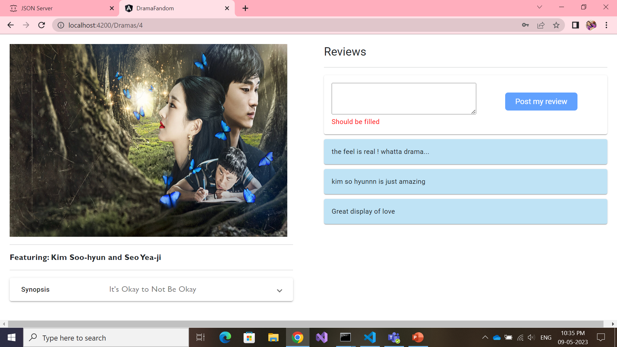
Dramas – View Page

Slide 9
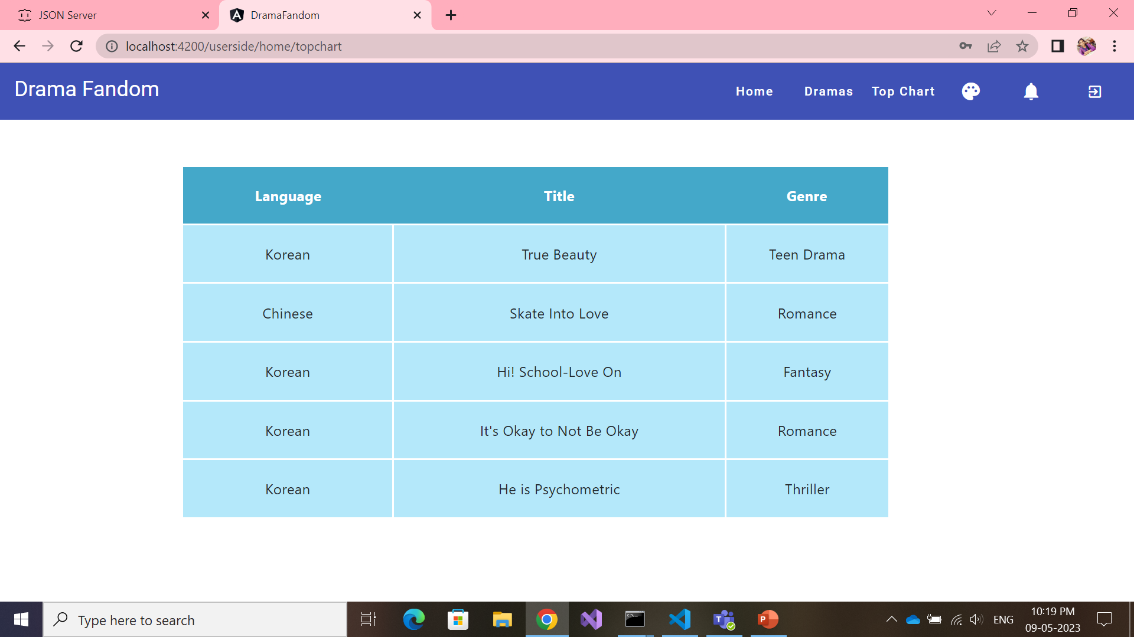
Top Chart

Slide 10
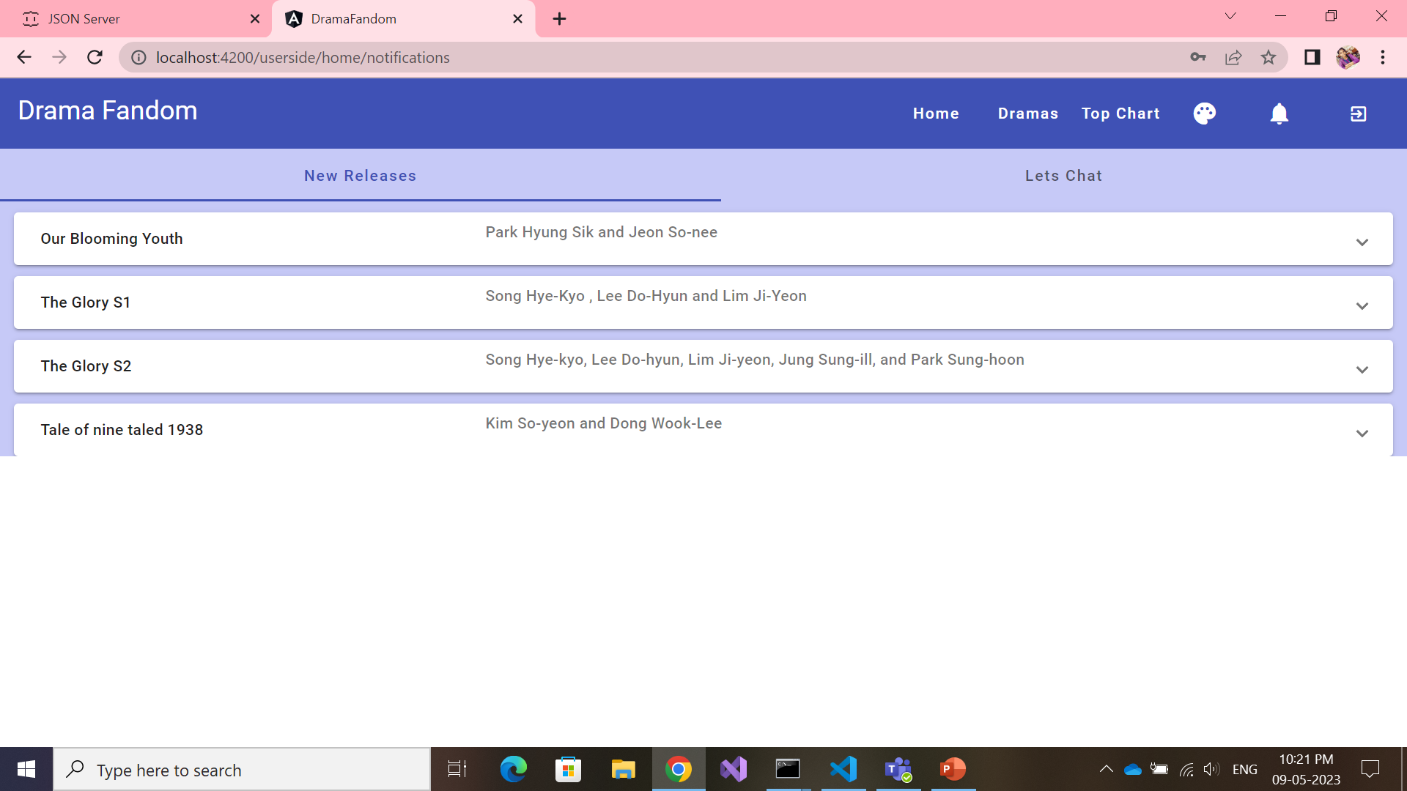
Notifications – Tab1- New Releases

Slide 11
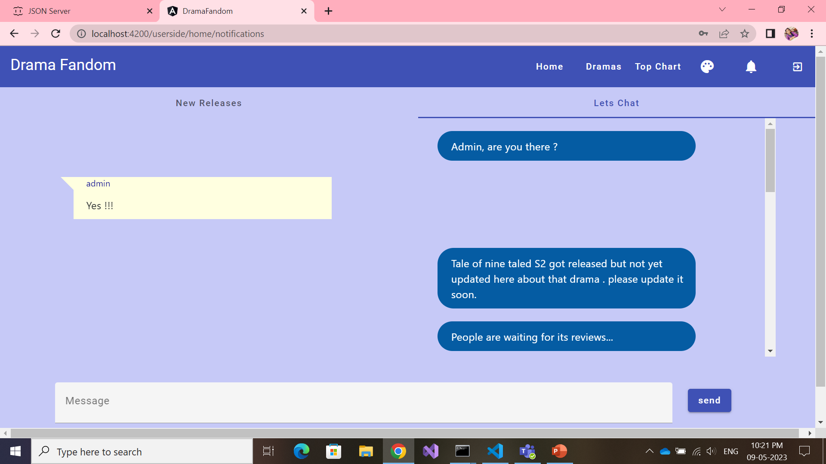
Notifications- Tab2- Chat Bot

Slide 12
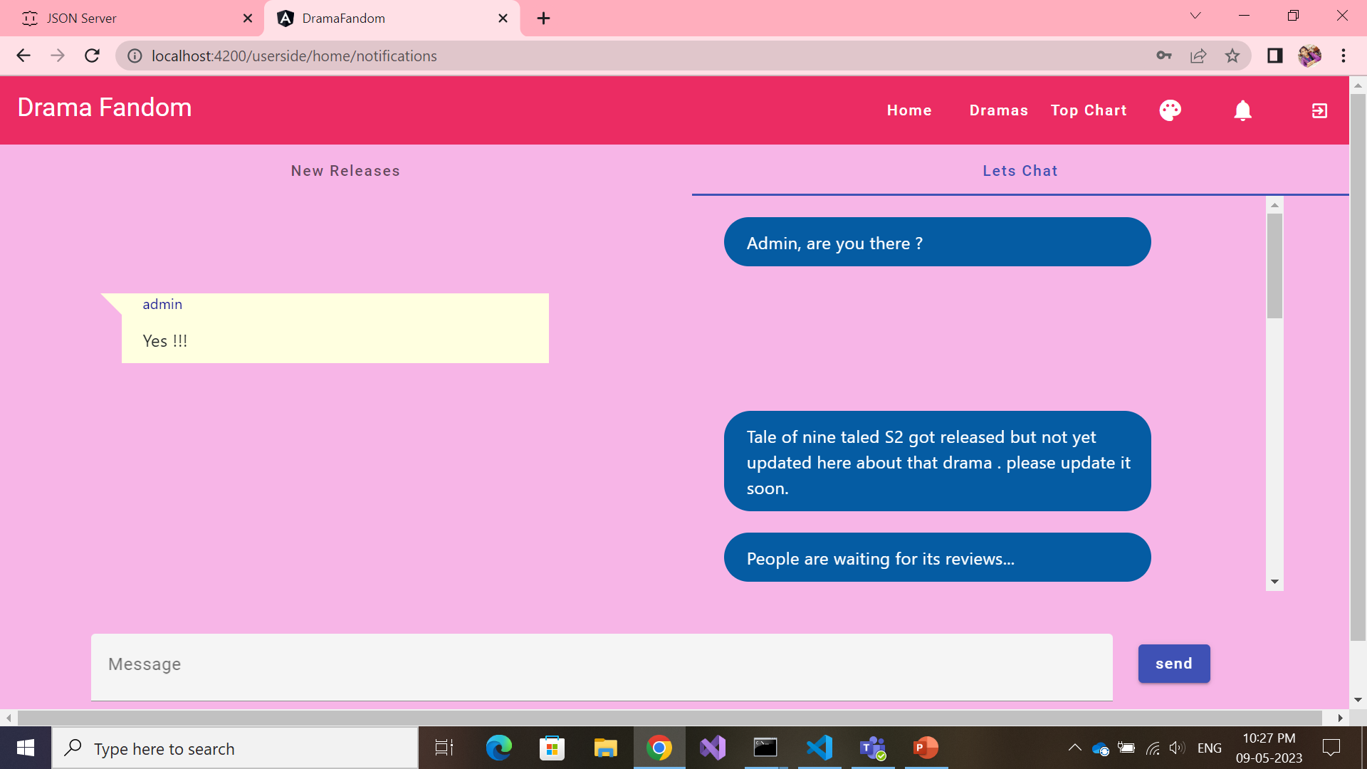
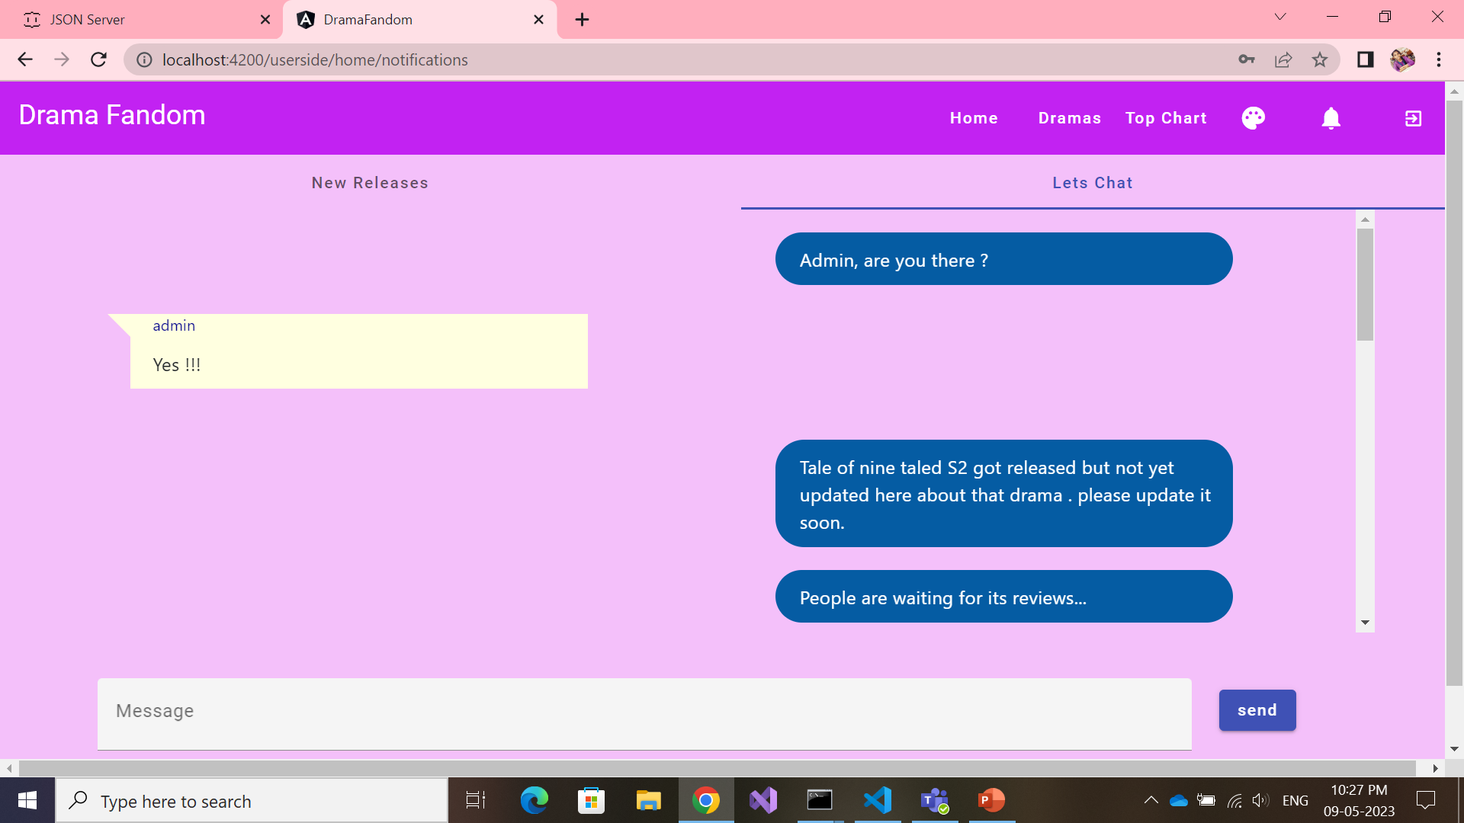
Theme Change

Slide 13
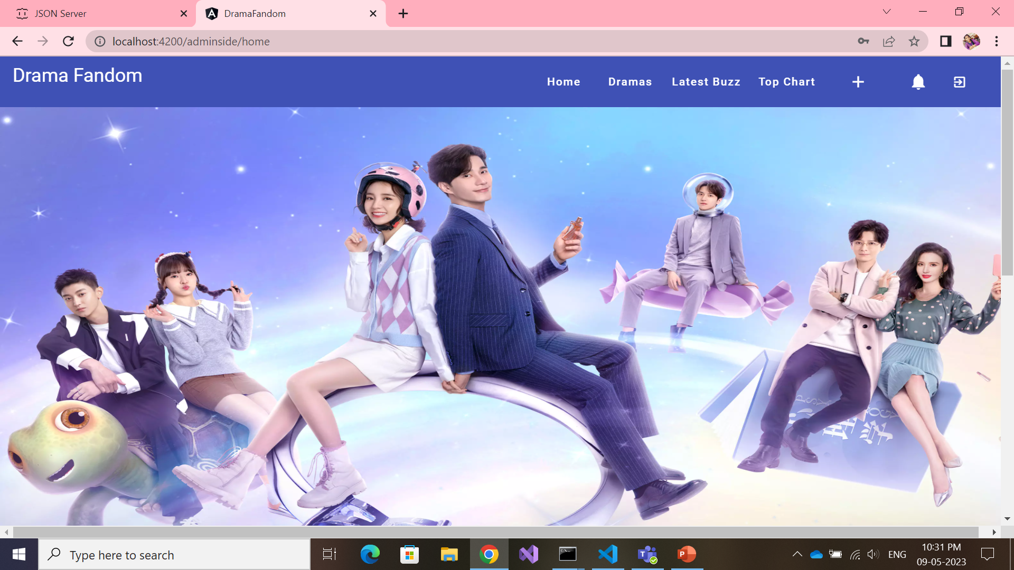
Admin Home Page

Slide 14
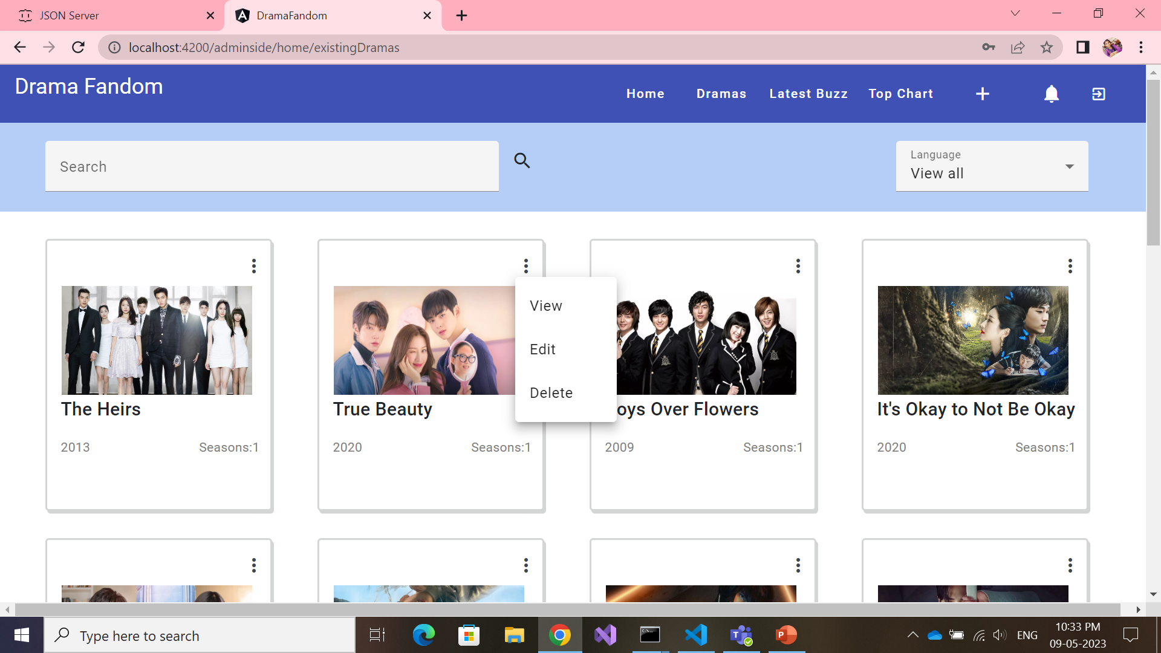
Admin Dramas Page- view,edit,delete

Slide 15
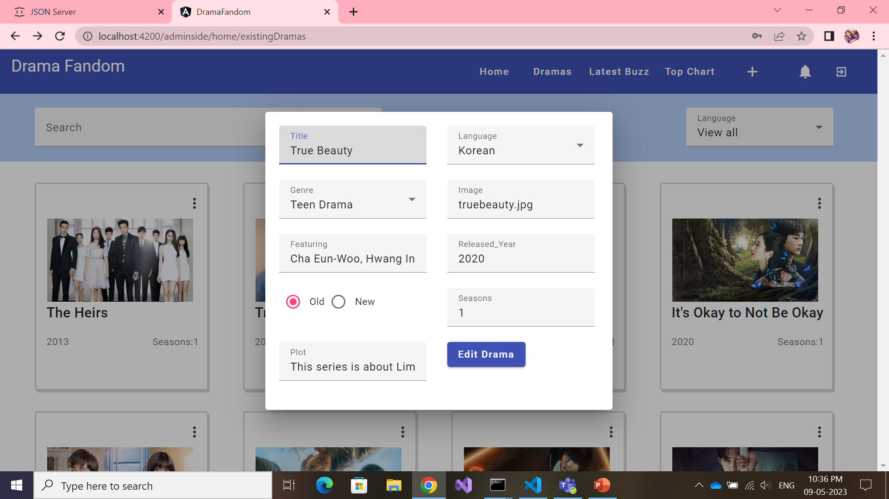
Admin Dramas Page- edit form

Slide 16
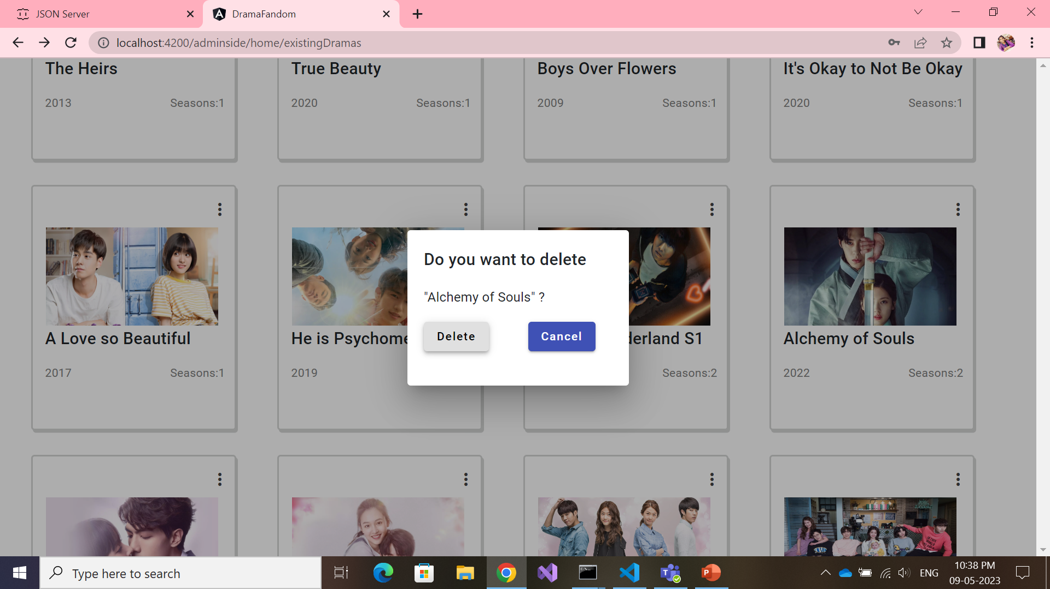
Admin Dramas Page- delete

Slide 17
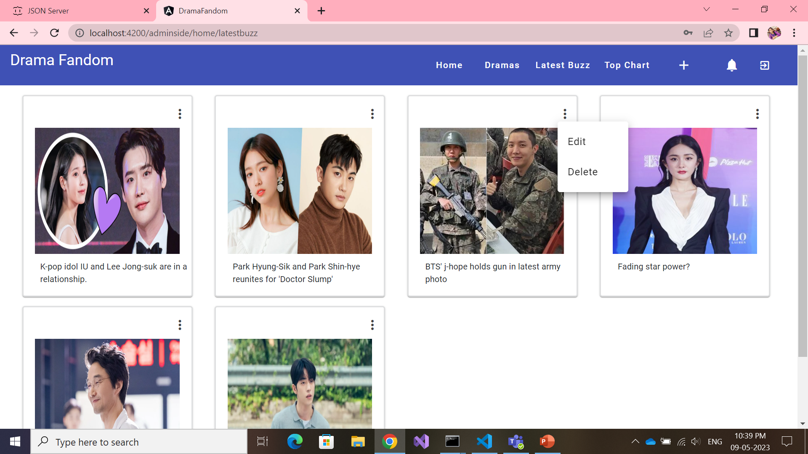
Admin side – Latest Buzz

Slide 18
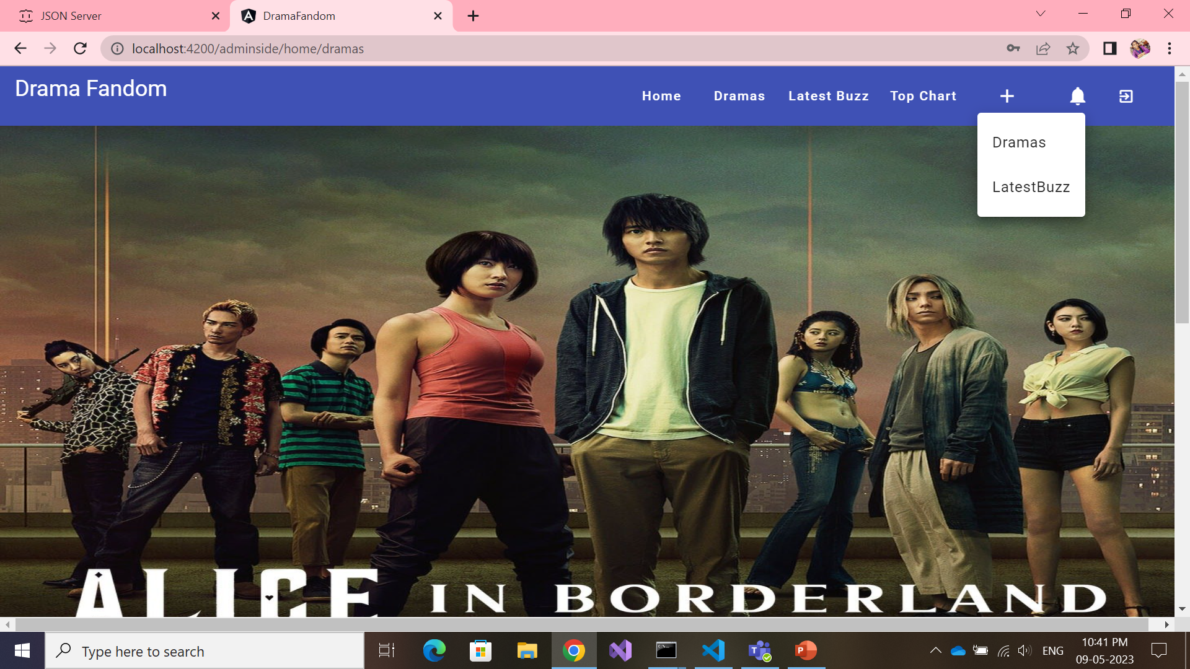
Admin side – Add new Drama/Buzz

Slide 19
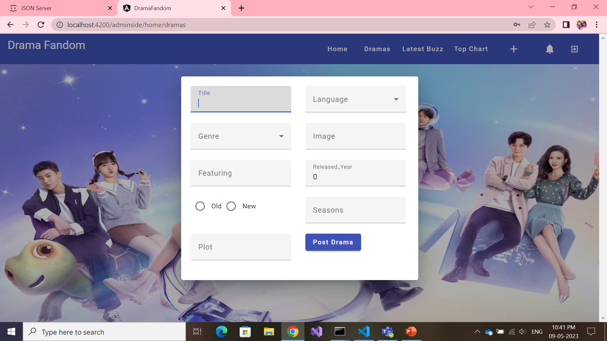
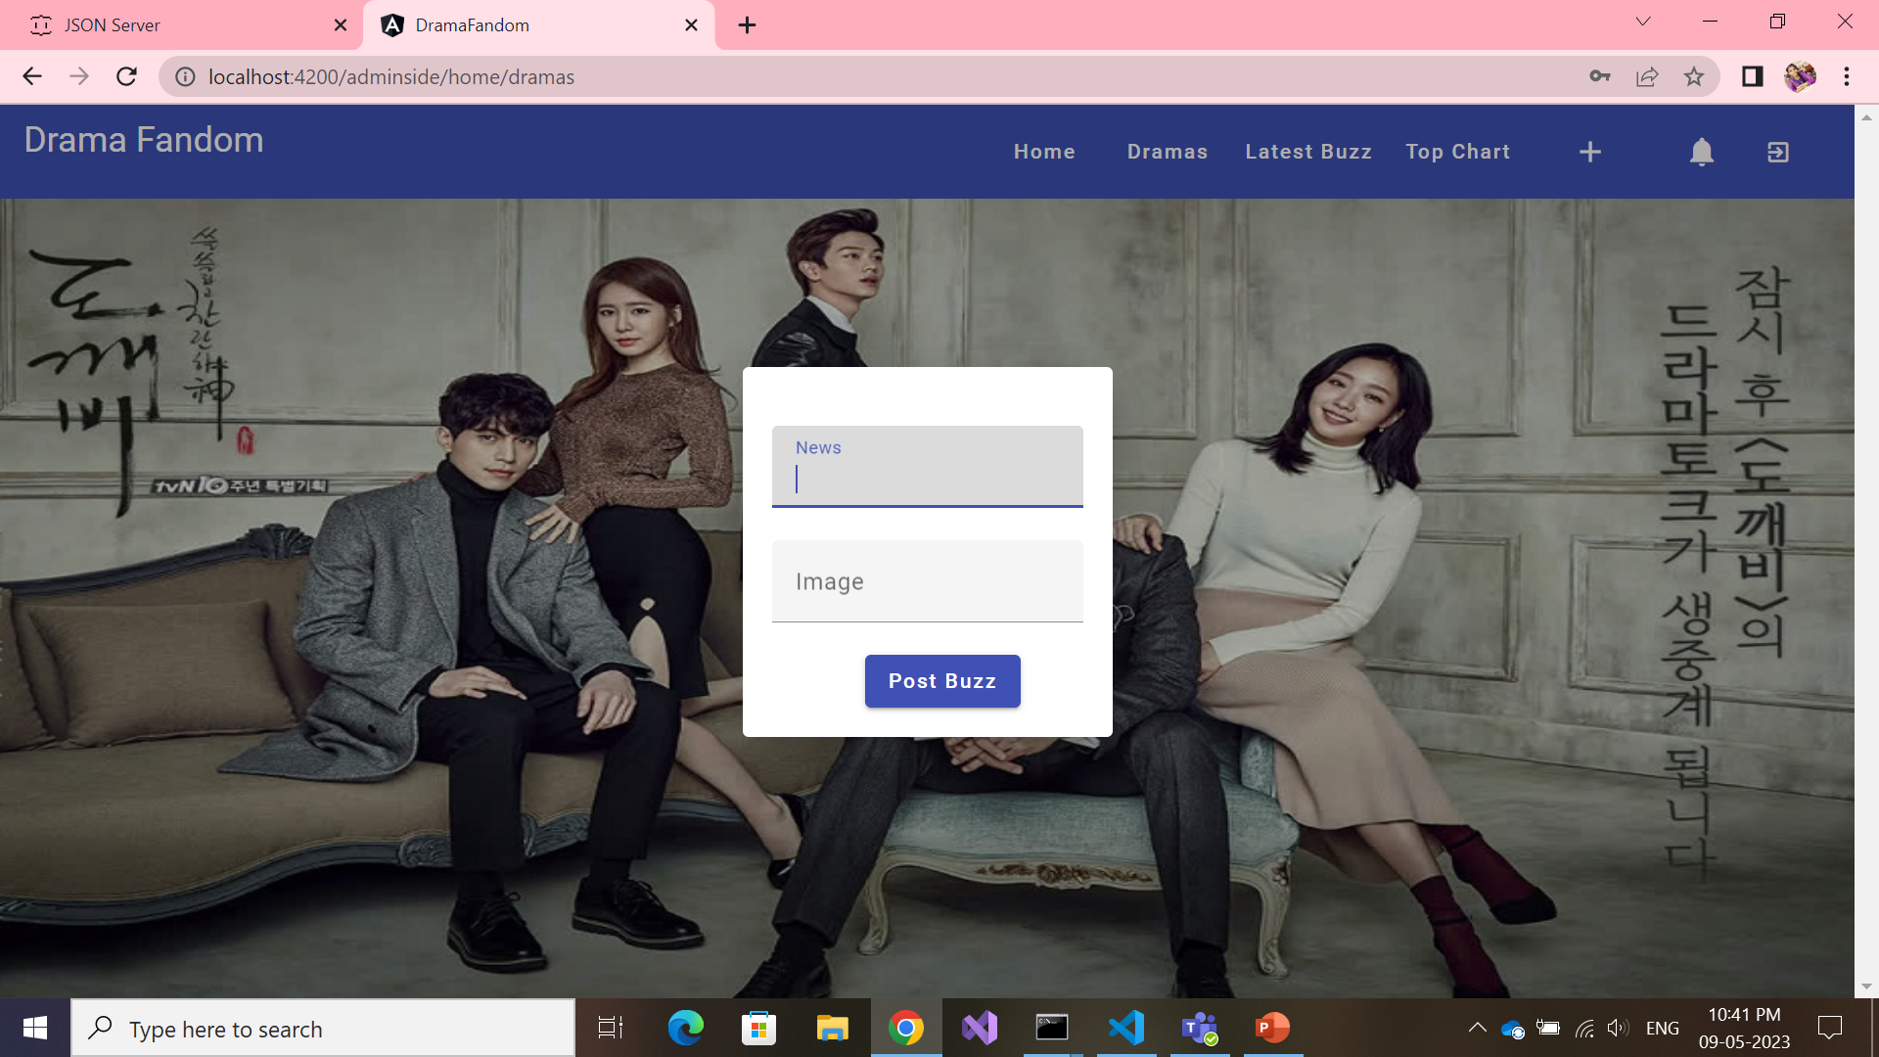
Admin side – Add new Drama/Buzz

Slide 20
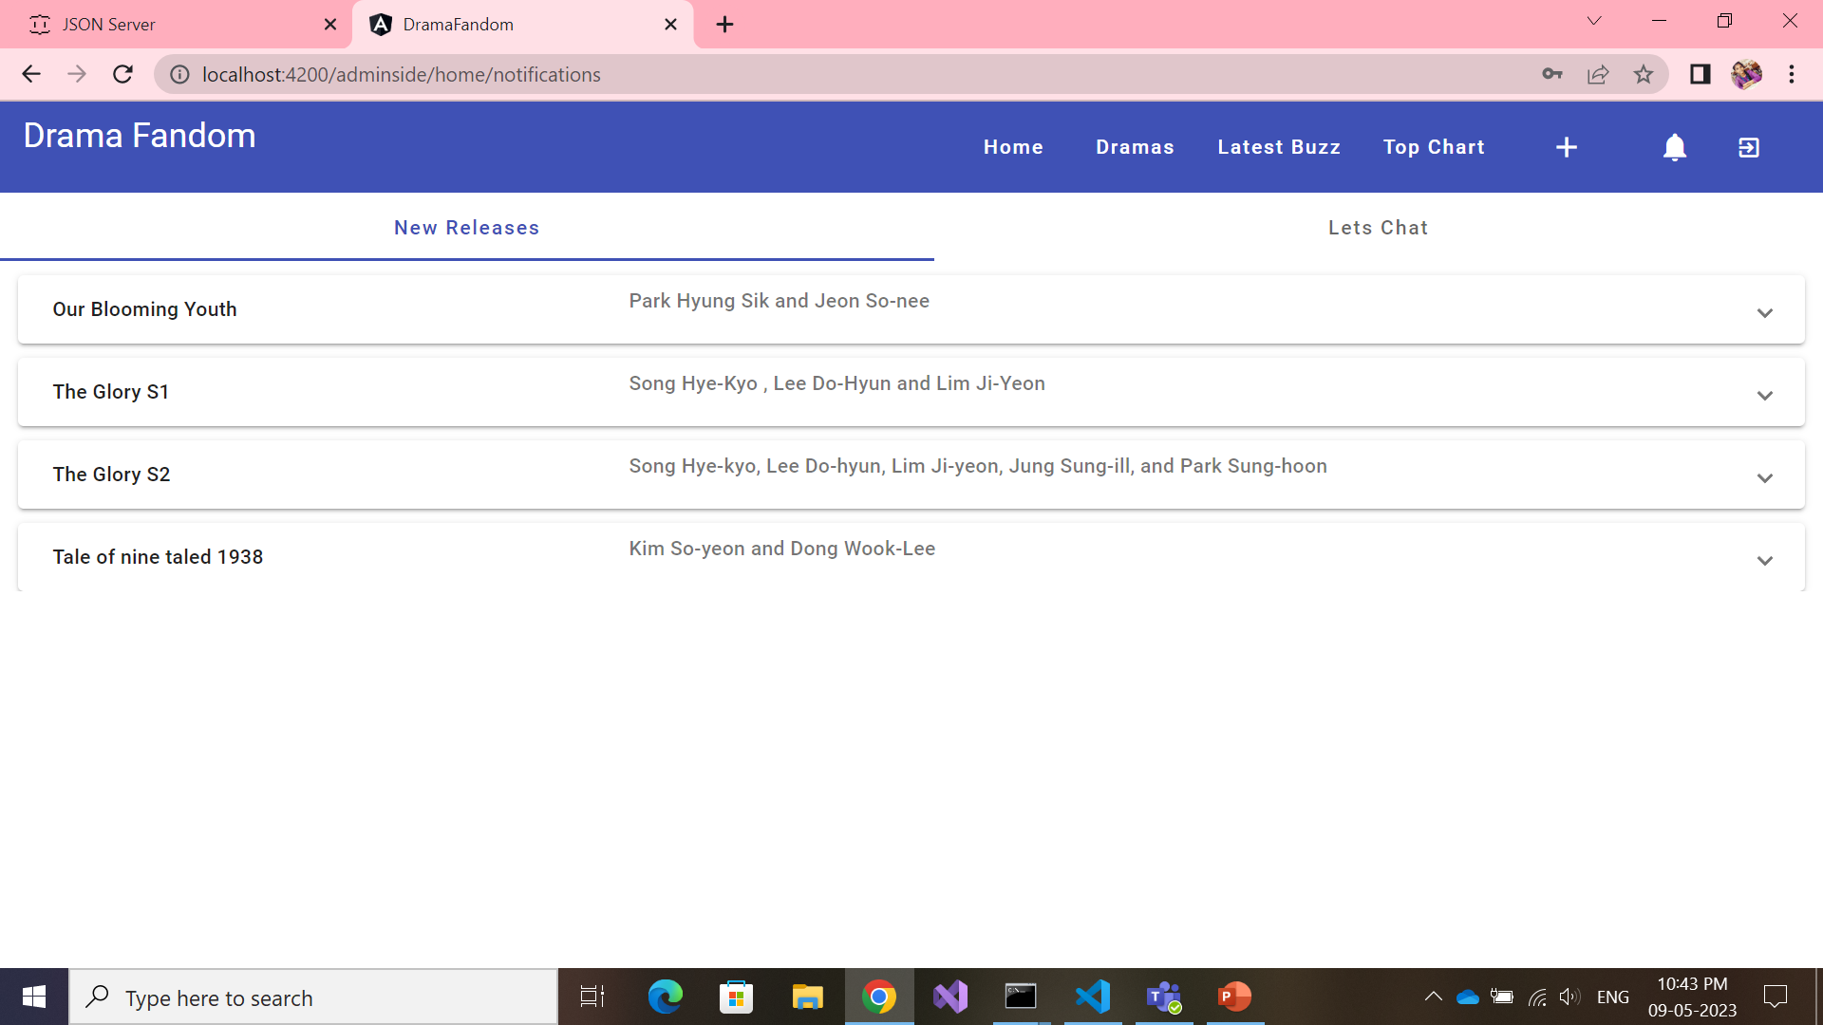
Admin side – Notifications – Tab1

Slide 21
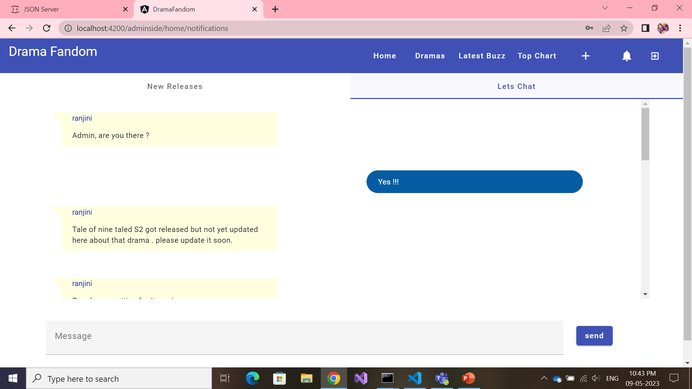
Admin side – Notifications – Tab2

Slide 22




Concepts Implemented
With PowerPoint, you can create presentations and share your work with others, wherever they are. Type the text you want here to get started. You can also add images, art, and videos on this template. Save to OneDrive and access your presentations from your computer, tablet, or phone.

Slide 23


Thank you
Presenter name
Email address
Website

